Slide 1

Skills for Success with Microsoft Office 2016 Volume 1
by Margo Chaney Adkins, Catherine Hain, Lisa Hawkins, and Stephanie Murre Wolf
Chapter 3
Browse the Internet
Notes:
Skills for Success with Microsoft Office 2016 Volume 1

Slide 2
Skills
Browse from the Desktop
Browse from the Start Menu and Add Favorites
Navigate and Search Websites
Use Accelerators and Search Providers
Manage Browser Tabs and Use Reading View
Notes:
The skills of this chapter are:
Browse from the Desktop
Browse from the Start Menu and Add Favorites
Navigate and Search Websites
Use Accelerators and Search Providers
Manage Browser Tabs and Use Reading View
The skills continue on the next slide.

Slide 3
Skills (cont.)
Organize Favorites
Print and Save Web Pages
View and Delete Browsing History
Protect Online Privacy
Create Web Notes
Notes:
The skills of this chapter are:
Organize Favorites
Print and Save Web Pages
View and Delete Browsing History
Protect Online Privacy
Create Web Notes

Slide 4
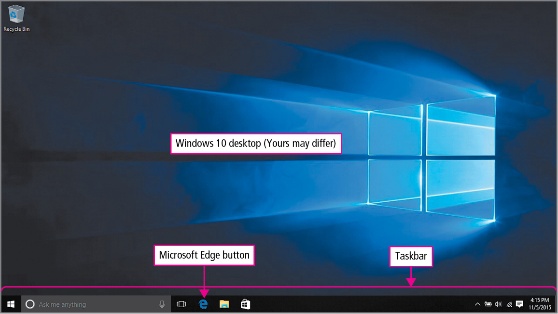
Skill 1: Browse from the Desktop
Notes:
Programs used to navigate the World Wide Web are called web browsers.
To maximize the area devoted to the web page when viewed on mobile devices, Microsoft Edge displays buttons and commands only when you need them. For example, you can access multiple pages and other tools in the app commands area.
If the Microsoft Edge button is not on your taskbar, you can open Internet Explorer from the Start screen and navigate to the page. Then, in the app commands, click Page tools, and View on the desktop.

Slide 5
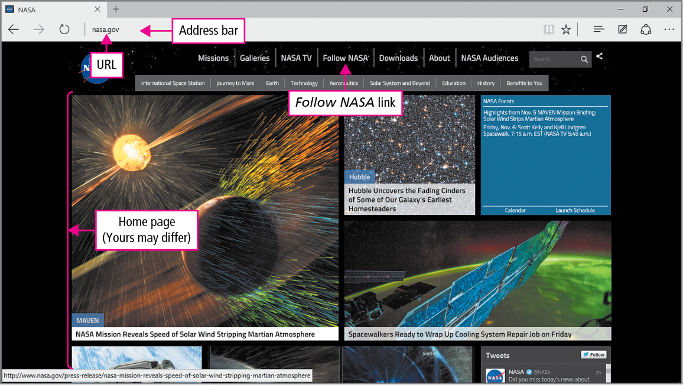
Skill 1: Browse from the Desktop (cont.)
Notes:
When you start Microsoft Edge, the page that displays is called the default home page.
A URL is a unique address of a page on the Internet and an acronym for Uniform Resource Locator.
When you type in the address bar, the address bar Autocomplete list displays a list of recently visited websites. You can navigate to these sites by clicking them. Here, URLs from http://nps.gov and http://npr.org have been visited. Your list will be different.
The text usa.gov is a domain name, which is a unique name assigned to a website on the World Wide Web. The text http:// will be inserted automatically before the domain name after you navigate to the page.

Slide 6
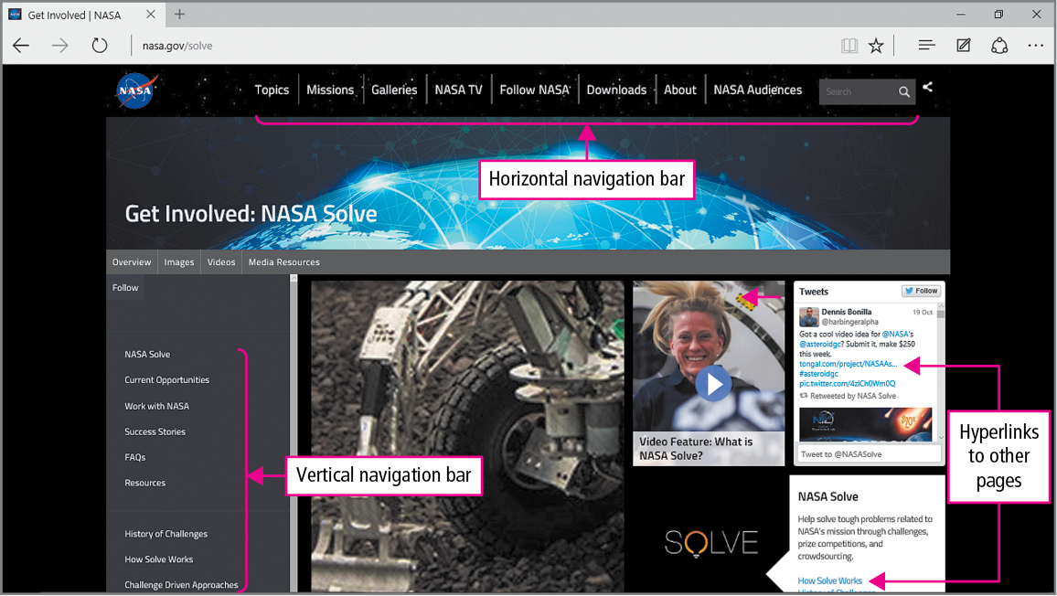
Skill 1: Browse from the Desktop (cont.)
Notes:
Because the web is dynamic, the page on your computer may be different than the version shown in the figure. Here, the page displays hyperlinks—any text or pictures that can be clicked to move to a new page or location.
Most web pages have a navigation bar with hyperlinks to the main pages of the site. Here, the page has a horizontal navigation bar that spans across the page.

Slide 7
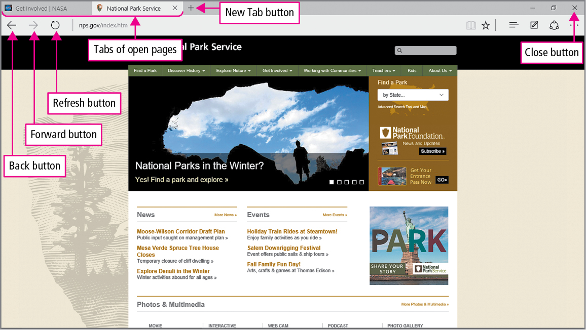
Skill 1: Browse from the Desktop (cont.)
Notes:
The navigation area of Microsoft Edge has Back and Forward buttons to move backward or forward through your recently browsed pages.

Slide 8
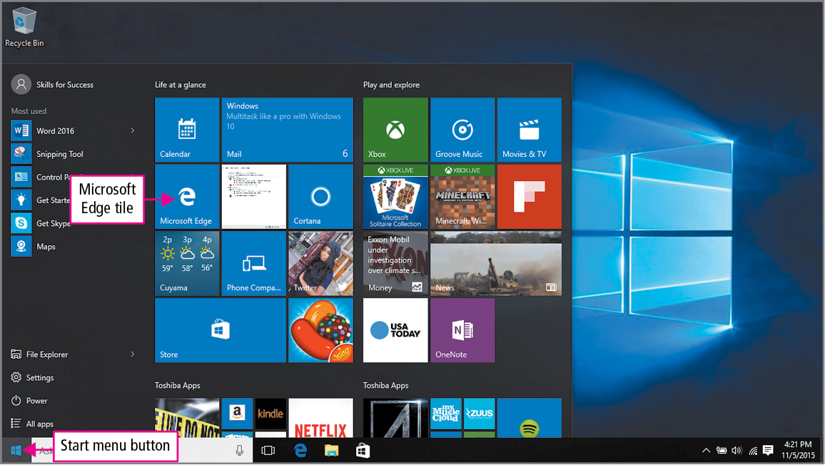
Skill 2: Browse from the Start Menu and Add Favorites
Notes:
You can open Microsoft Edge from an app on the Start menu.
A favorite is a stored web address that can be clicked to navigate to that page quickly.

Slide 9
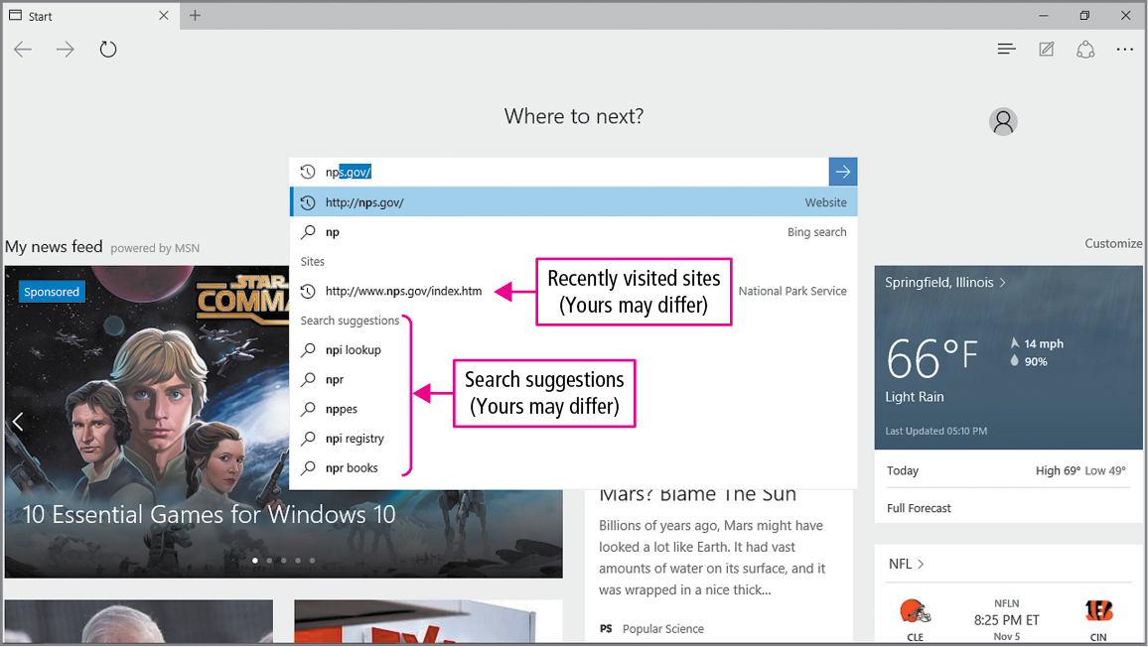
Skill 2: Browse from the Start Menu and Add Favorites (cont.)
Notes:
A website is a collection of connected pages located at a single domain name. Large websites can consist of thousands of individual pages.

Slide 10
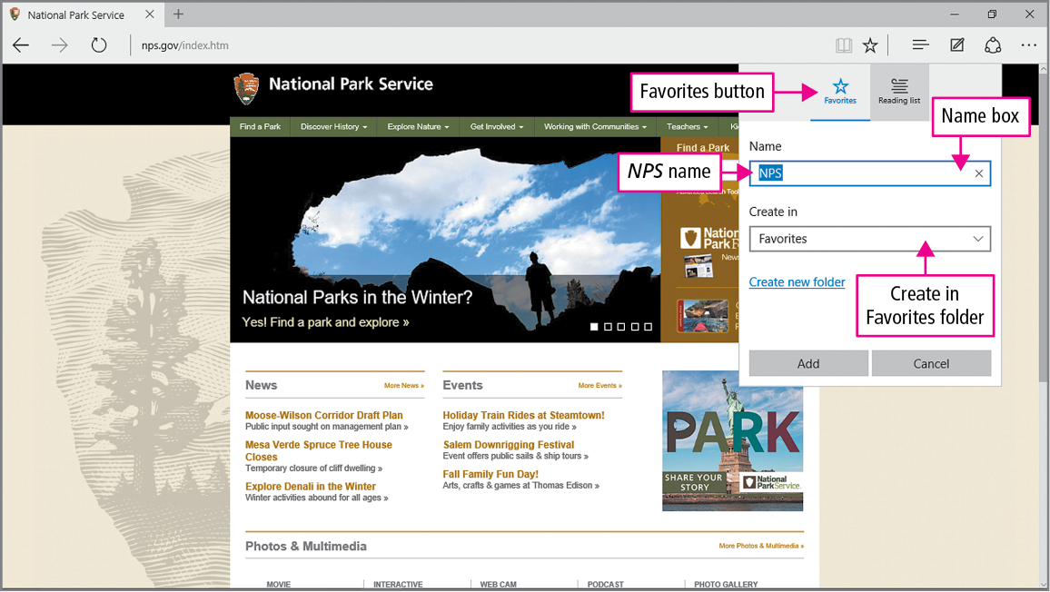
Skill 2: Browse from the Start Menu and Add Favorites (cont.)
Notes:
On the command bar, the Favorites button displays the Favorites Center where favorite websites can be added.
Favorite Pages can quickly be revisited by using the favorites button in the command bar.

Slide 11
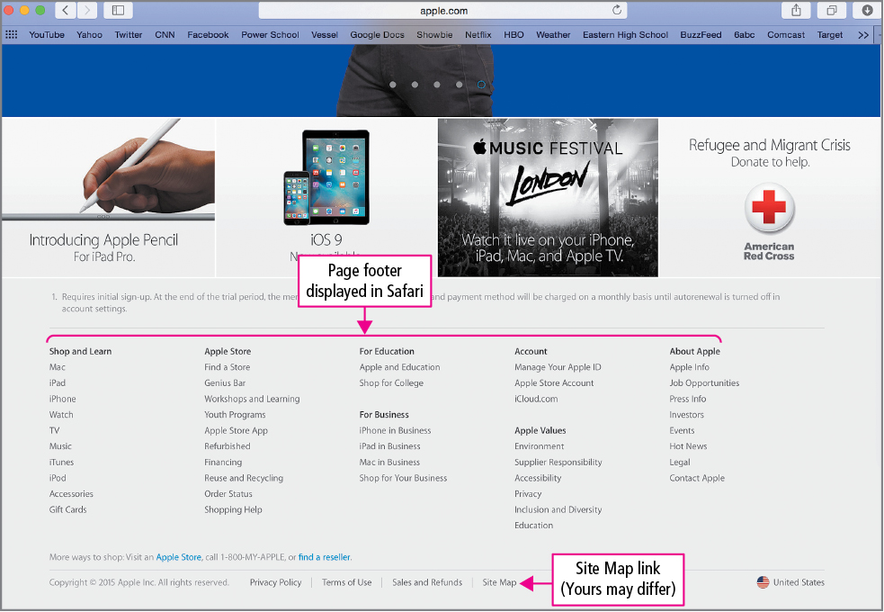
Skill 3: Navigate and Search Websites
Notes:
Large websites provide navigation bars, hyperlinks, and their own search boxes, all of which you can use to find the pages you need.
Web page footers typically provide links to a site index, copyright information, and a link to contact the organization.

Slide 12
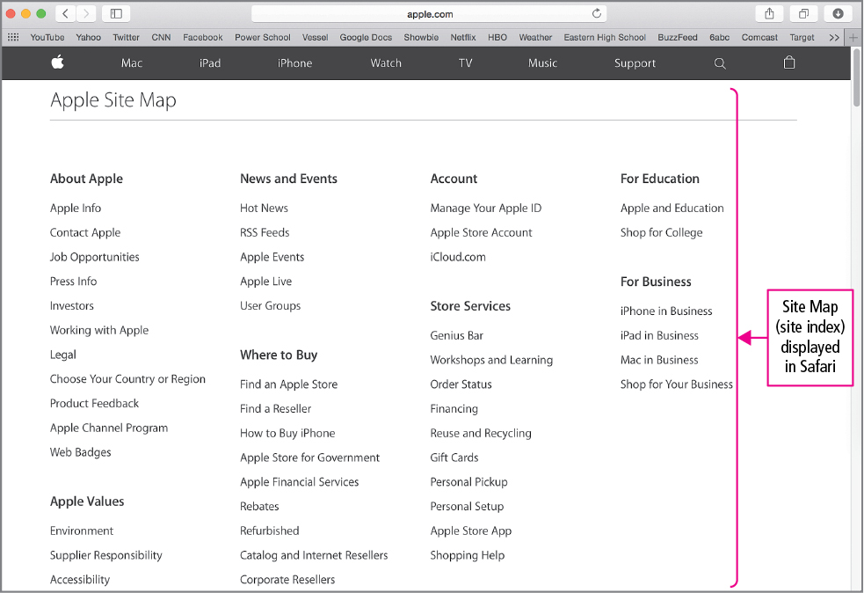
Skill 3: Navigate and Search Websites (cont.)
Notes:
A site index is sometimes called a site map, which is a page of hyperlinks that outline a website.

Slide 13
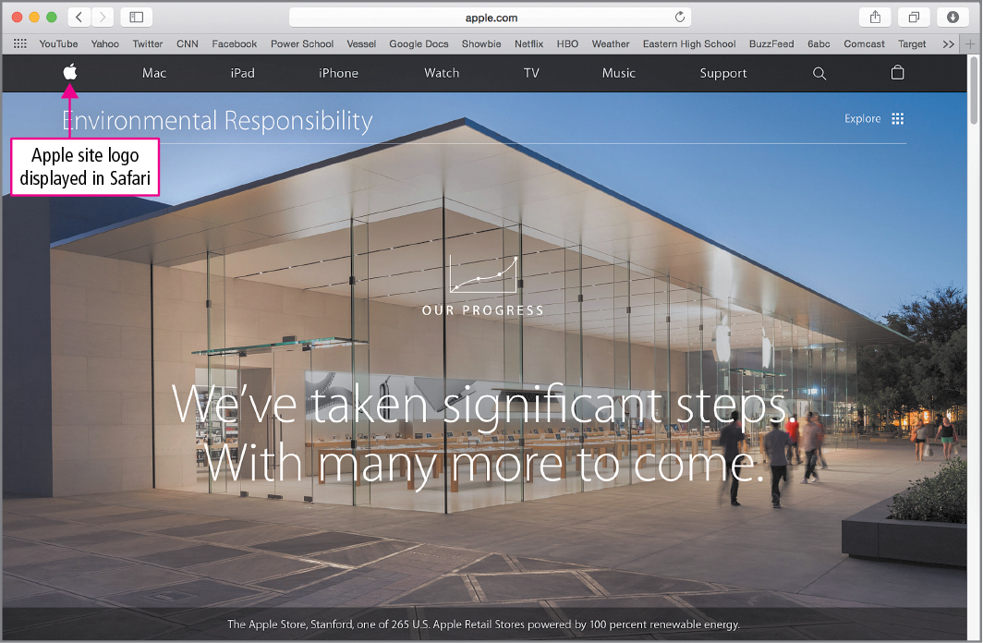
Skill 3: Navigate and Search Websites (cont.)
Notes:
The pointer displays whenever you point to a hyperlink. Clicking a site logo typically takes you to the site’s home page.

Slide 14
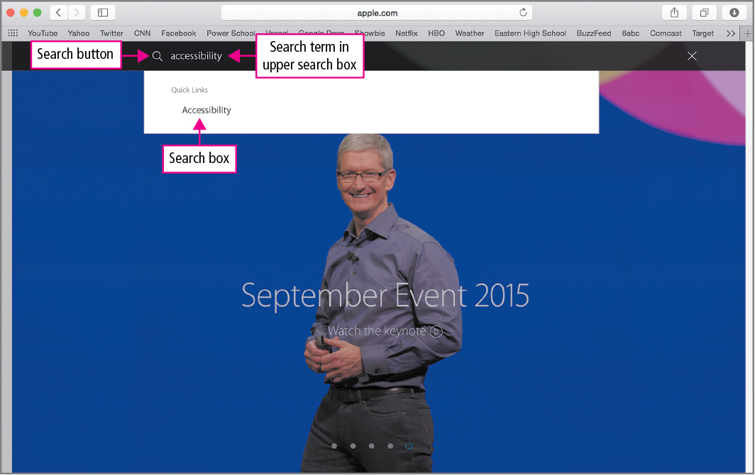
Skill 3: Navigate and Search Websites (cont.)
Notes:
After typing your search term in the Search box, selecting the Go button will begin the search. The favorites button icon, located in the upper right-hand corner as a star, allows you to save your searches as favorites so that you can return to them quickly.

Slide 15
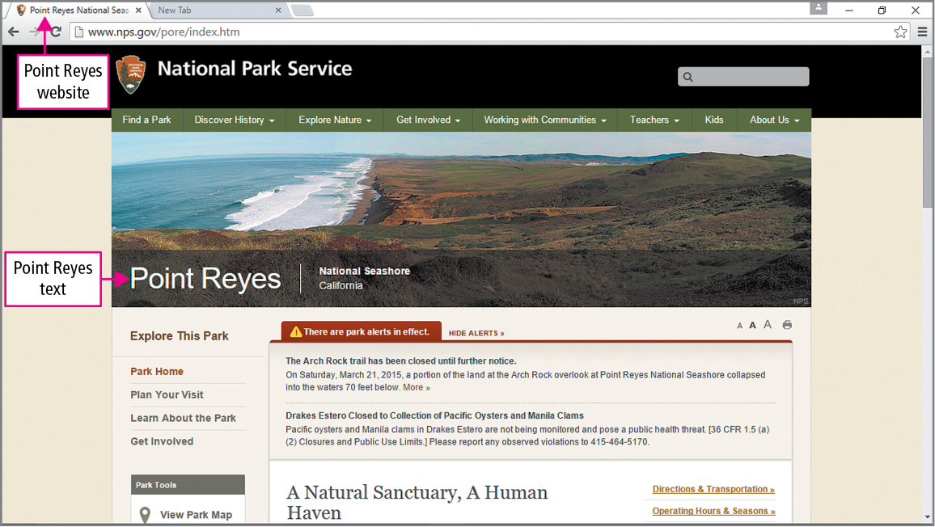
Skill 4: Use Accelerators and Search Providers
Notes:
An Accelerator is a feature that searches the web for information related to the text you select.
A search provider is a website that provides a way for you to search the World Wide Web.
Selected text is chosen by dragging through the words.

Slide 16
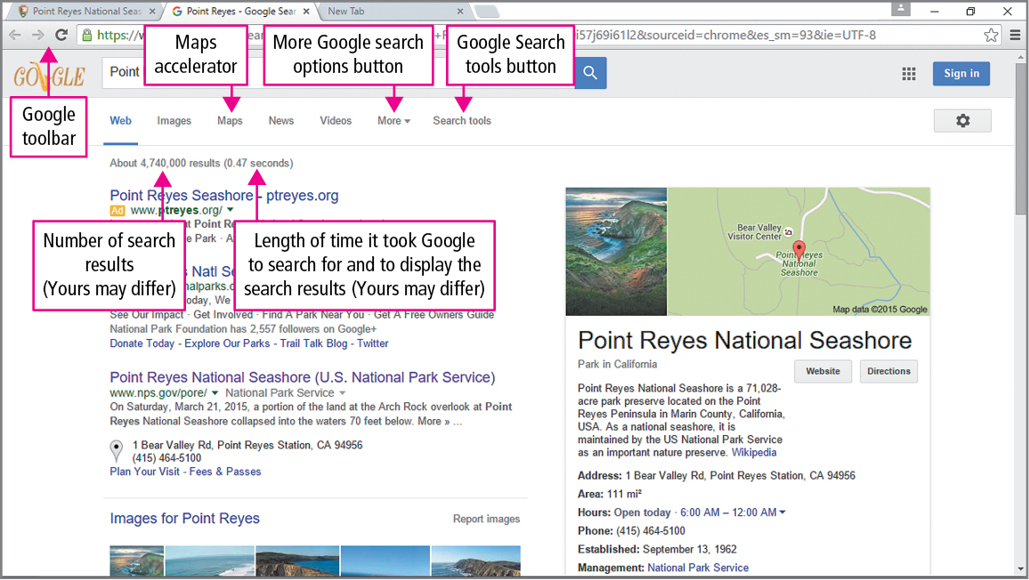
Skill 4: Use Accelerators and Search Providers (cont.)
Notes:
When you click an Accelerator, the page typically opens in a new tab. Tabbed browsing is a feature to open multiple web pages in the same browser window. Each page can be viewed by clicking its tab.

Slide 17
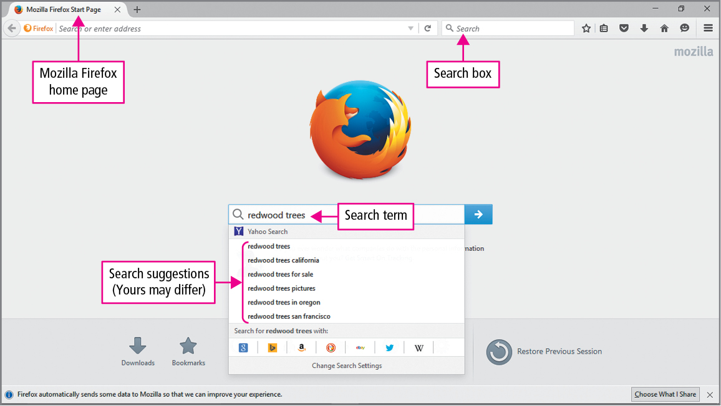
Skill 4: Use Accelerators and Search Providers (cont.)
Notes:
Search suggestions are the words and phrases that display as you type in a search box.

Slide 18
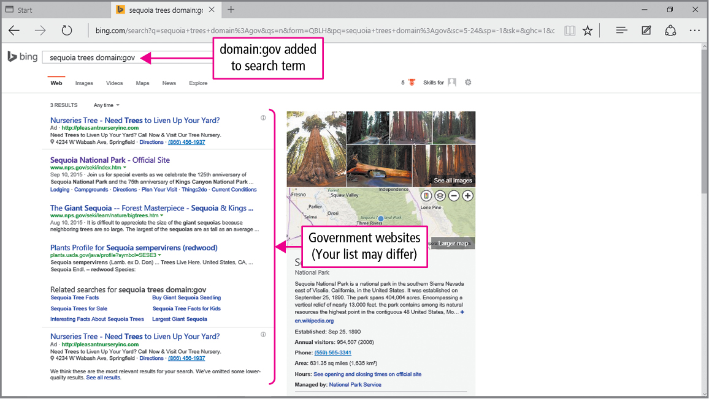
Skill 5: Manage Browser Tabs and Use Reading View
Notes:
You can use a keyboard shortcut when clicking a hyperlink so that the page opens in a new tab.
When multiple tabs are open, you can rearrange the tabs in the tab row by dragging them. You can also view thumbnails of each open tab using the taskbar.

Slide 19
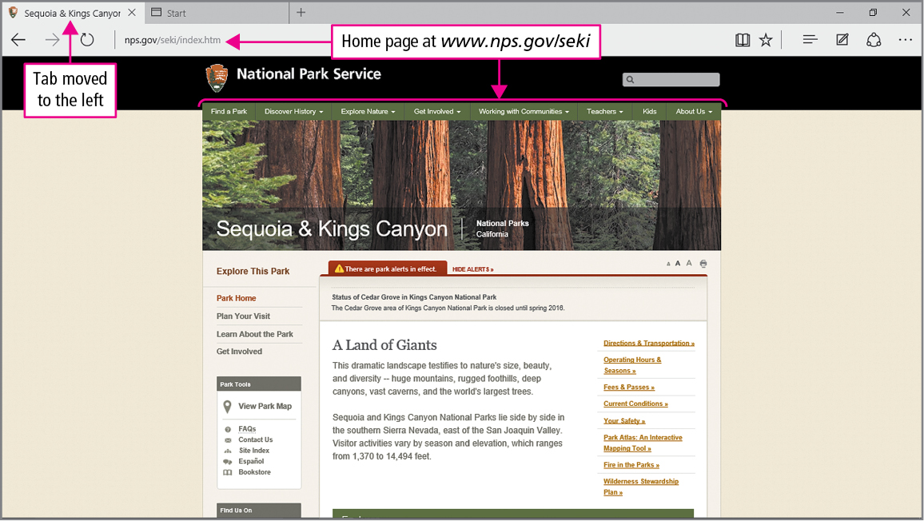
Skill 5: Manage Browser Tabs and Use Reading View (cont.)
Notes:
Top-level domains specify the organization type that sponsors a website and follow the period, pronounced as dot, which is after a website’s domain name. For example, federal and state government agencies use .gov, educational institutions use .edu, commercial entities use .com, and nonprofit organizations use .org. Most countries have their own top-level domain. A site from France, for example, may end with .fr.

Slide 20
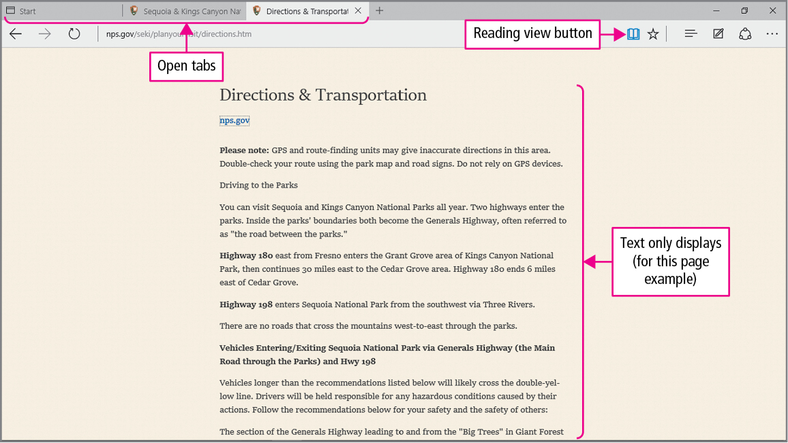
Skill 5: Manage Browser Tabs and Use Reading View (cont.)
Notes:
The Reading view is a webpage view that provides the webpage text without the navigation bars and hyperlinks displayed.

Slide 21
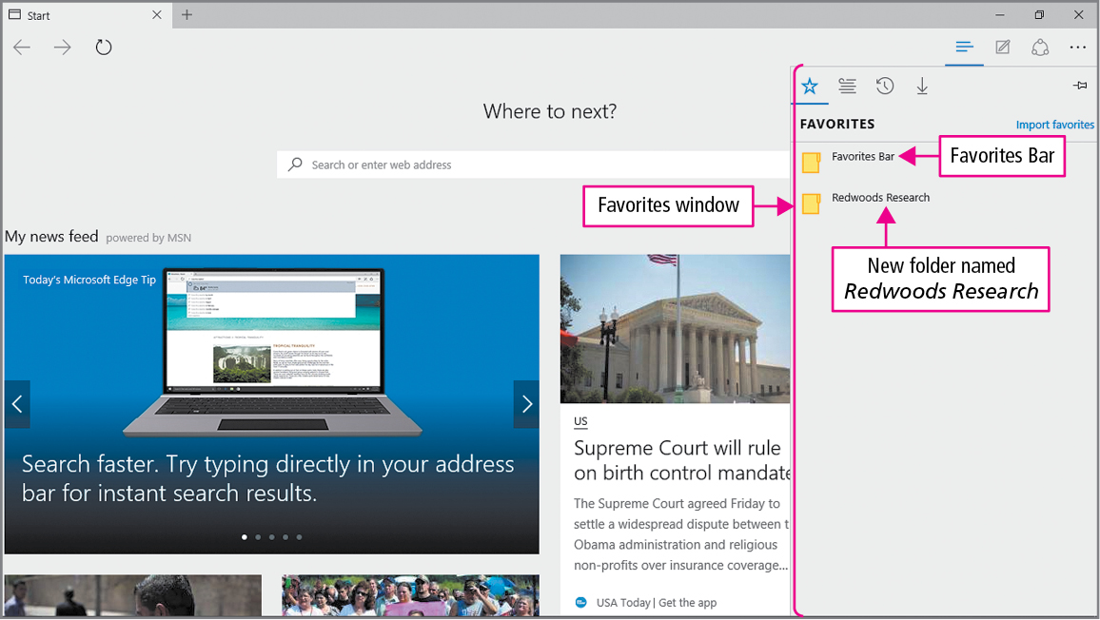
Skill 6: Organize Favorites
Notes:
Over time, your list of favorites may be quite long and may need to be organized. Files and folders can be created, moved, renamed, and deleted by using the Organize Favorites dialog box.

Slide 22
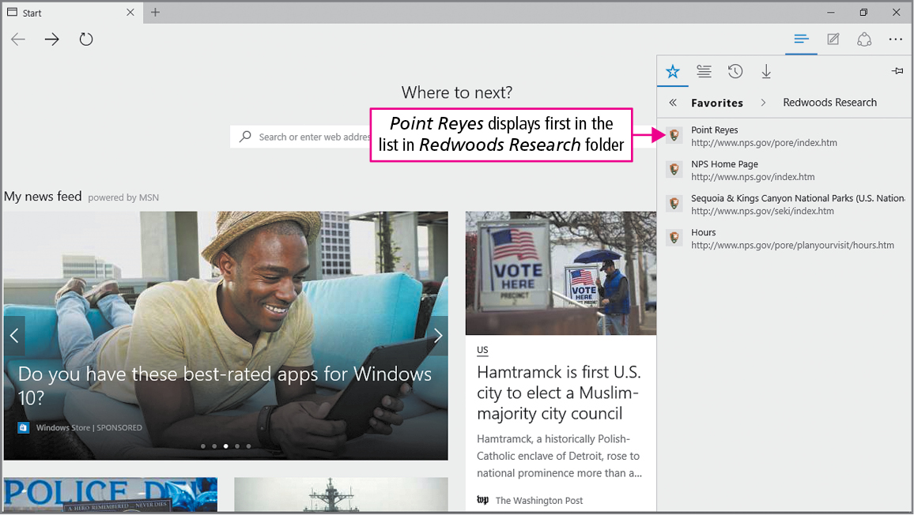
Skill 6: Organize Favorites (cont.)
Notes:
The selected folder has been moved to the Favorites bar folder where it will be easily accessible to display its list contents.

Slide 23
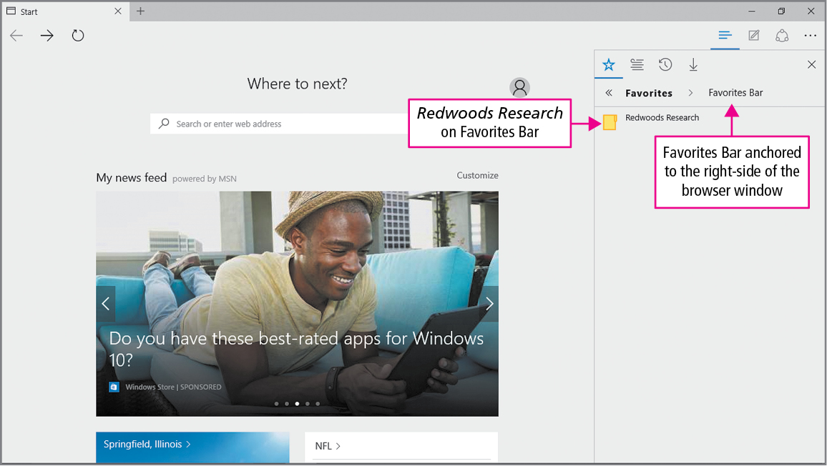
Skill 6: Organize Favorites (cont.)
Notes:
When a folder is added to the Favorites bar, it displays as a menu. An individual favorite folder or all folders can be opened by clicking the Open in tabs command.

Slide 24
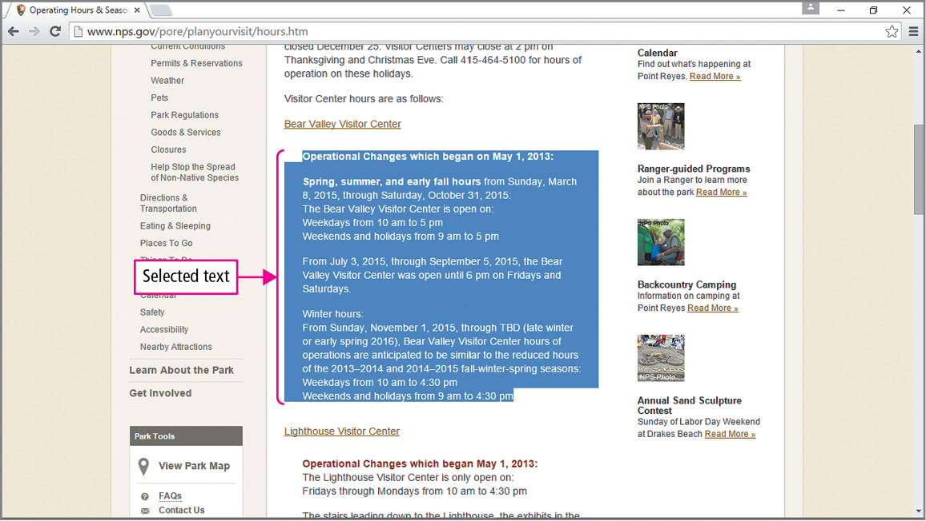
Skill 7: Print and Save Web Pages
Notes:
When information needs to be stored on a web page, you can print the page, print a selection of text or images on the page, or save the page to your drive.

Slide 25
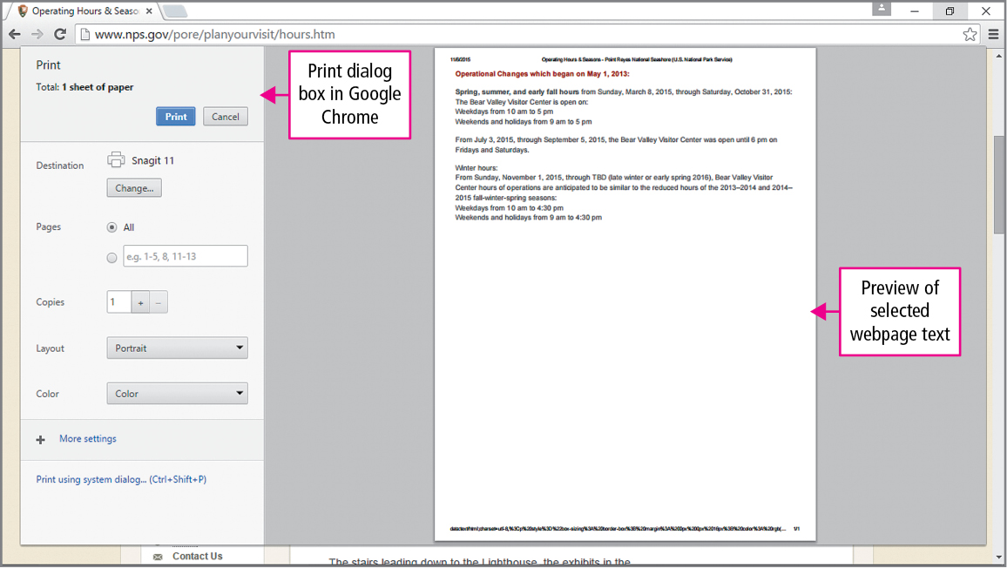
Skill 7: Print and Save Web Pages (cont.)
Notes:
Right-clicking the selected or highlighted text and using the Selection button in the Print Dialog box allows you to print only the information you need.

Slide 26
Skill 7: Print and Save Web Pages (cont.)
Notes:
The Save as type option in the Save Webpage dialog box allows files to be saved as different file types such as .pdf.

Slide 27
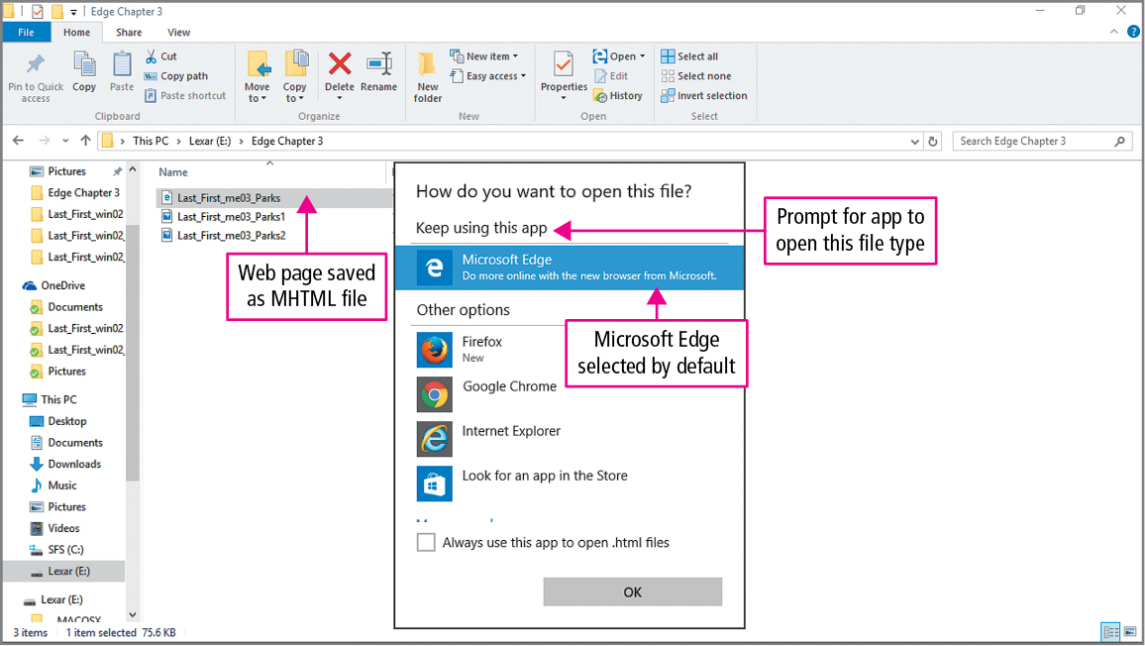
Skill 7: Print and Save Web Pages (cont.)
Notes:
A web page archive is a file that saves the web page text and pictures in a single file. These files are assigned the .mht file extension and are known as MHTML files.

Slide 28
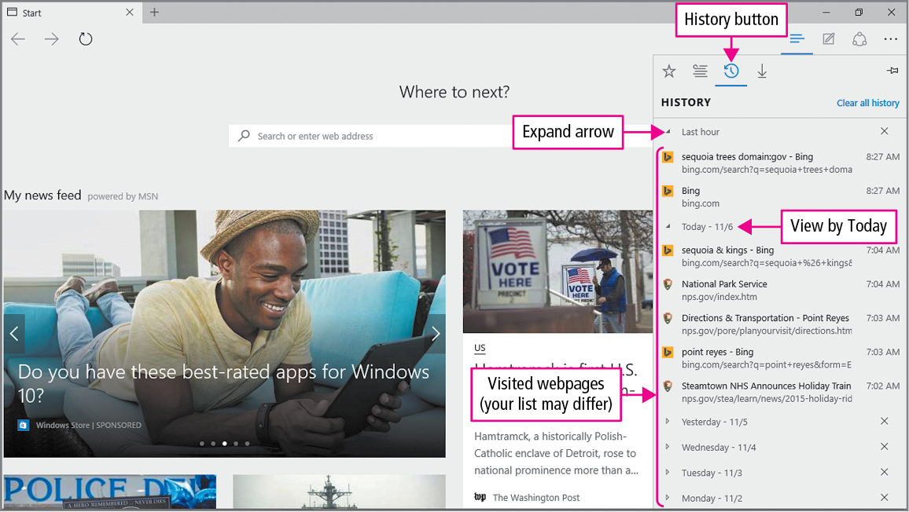
Skill 8: View and Delete Browsing History
Notes:
Your browsing history is the information that Microsoft Edge stores to help you browse more efficiently.
To view your browsing history, open Microsoft Edge, in the Favorites Center, click the History button.

Slide 29
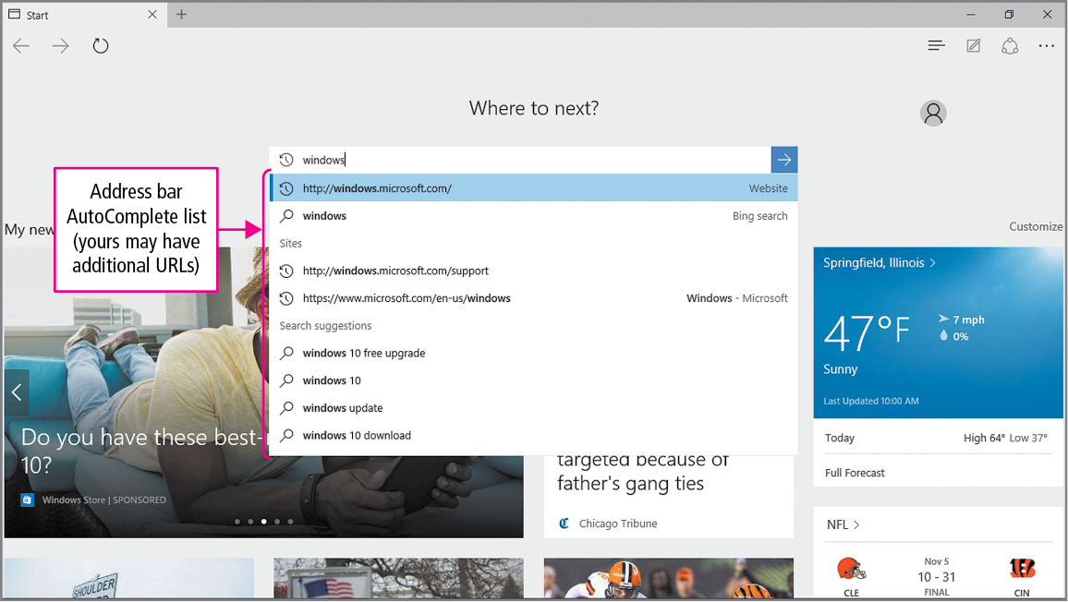
Skill 8: View and Delete Browsing History (cont.)
Notes:
When you type a URL in the address bar of Microsoft Edge, your address bar Autocomplete list displays a list of sites matching your history list.

Slide 30
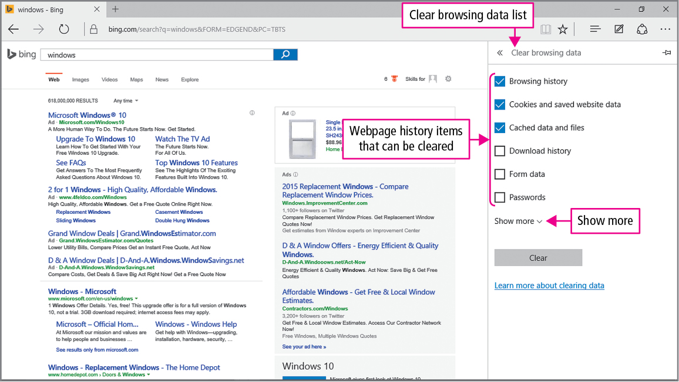
Skill 8: View and Delete Browsing History (cont.)
Notes:
To delete your browsing history, in the command bar, click the More actions button. Click Settings, and then under Clear browsing data, click the Choose what to clear button.

Slide 31
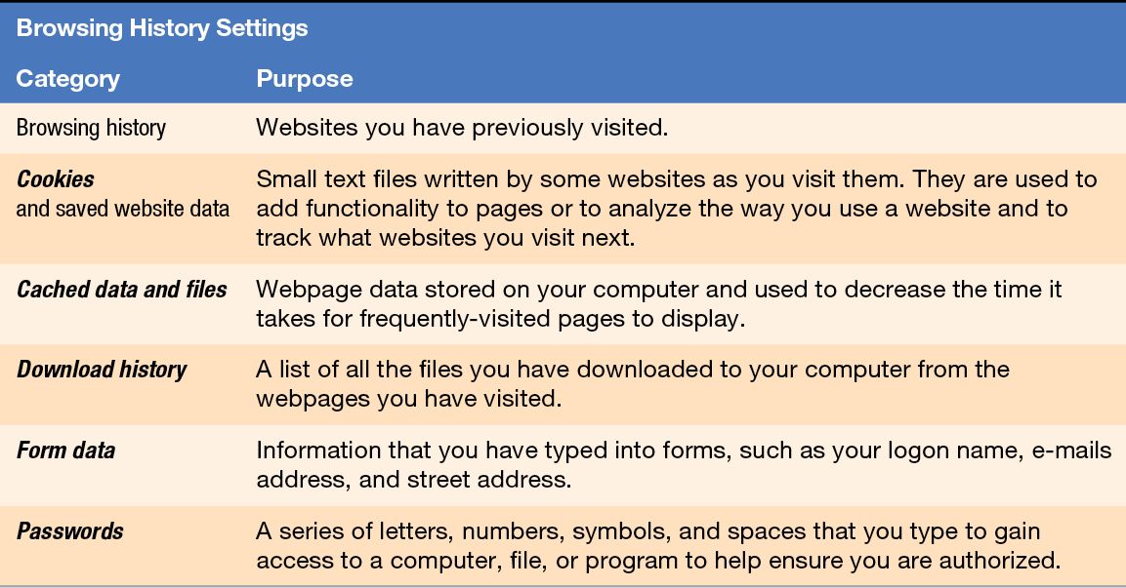
Skill 8: View and Delete Browsing History (cont.)
Notes:
You can choose which portions of your browsing history to delete.
When using a public computer, a computer that is available to others when you are not using it, you should delete your browsing history before logging off of the computer.

Slide 32
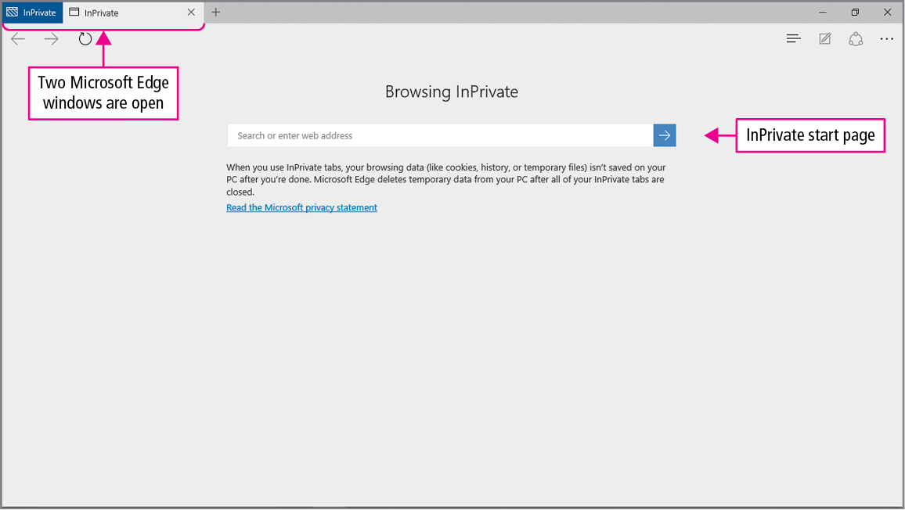
Skill 9: Protect Online Privacy
Notes:
If you want to protect your online privacy, you can do so with InPrivate Browsing in Microsoft Edge.
InPrivate Browsing is a Microsoft Edge window that limits what is stored in the browsing history. You can also allow or prevent specific sites from writing cookies on your computer.
InPrivate Browsing opens a new Microsoft Edge window and is only in effect when that specific window is used.

Slide 33
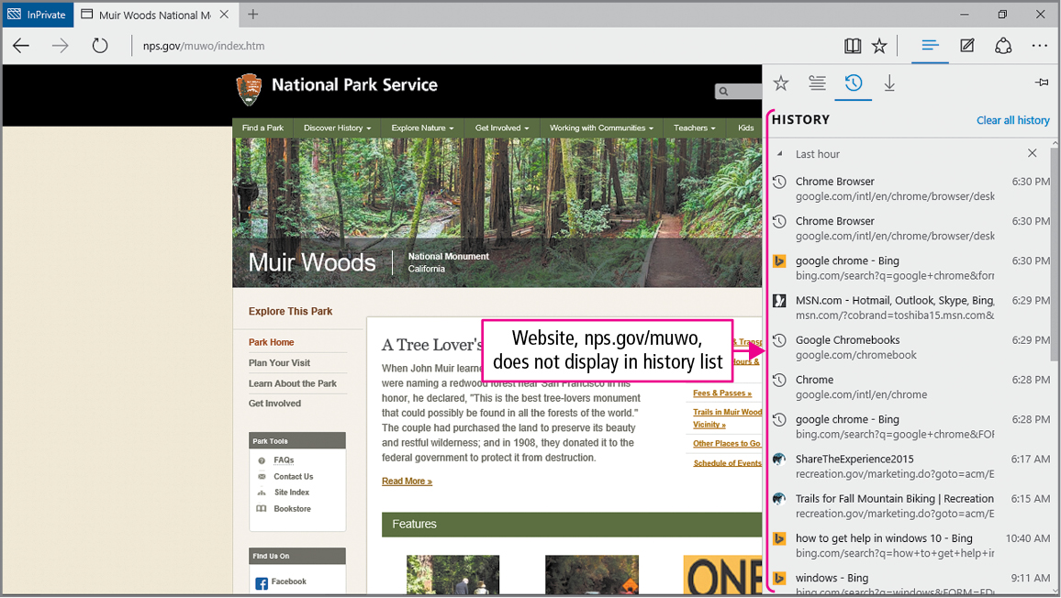
Skill 9: Protect Online Privacy (cont.)
Notes:
When using InPrivate Browsing, you can view a Privacy Report, which will tell you if a site wrote any cookies to your computer.
Typically, cookies are stored in your personal folder. With InPrivate Browsing, the cookies are stored in your computer’s RAM. RAM is a computer’s temporary electronic memory. When the browser window is closed, the cookie is removed from RAM.

Slide 34
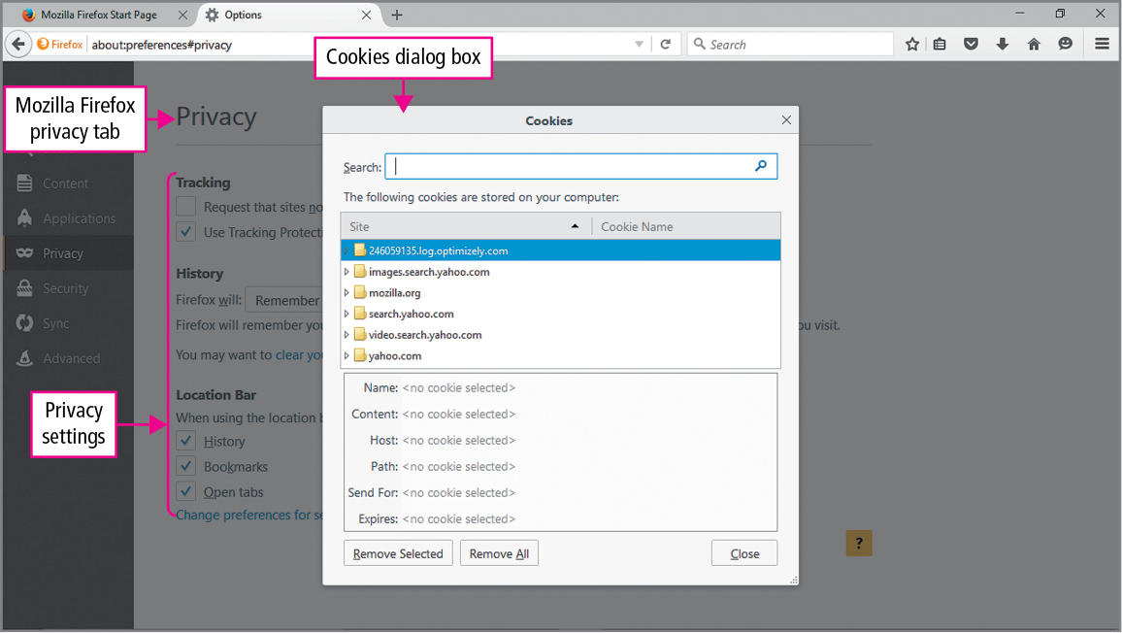
Skill 9: Protect Online Privacy (cont.)
Notes:
The privacy level you select determines when cookies can be stored on your computer.
With privacy set to high, only the sites you allow can write cookies.
In this case, only nps.gov sites will be permitted to do so.

Slide 35
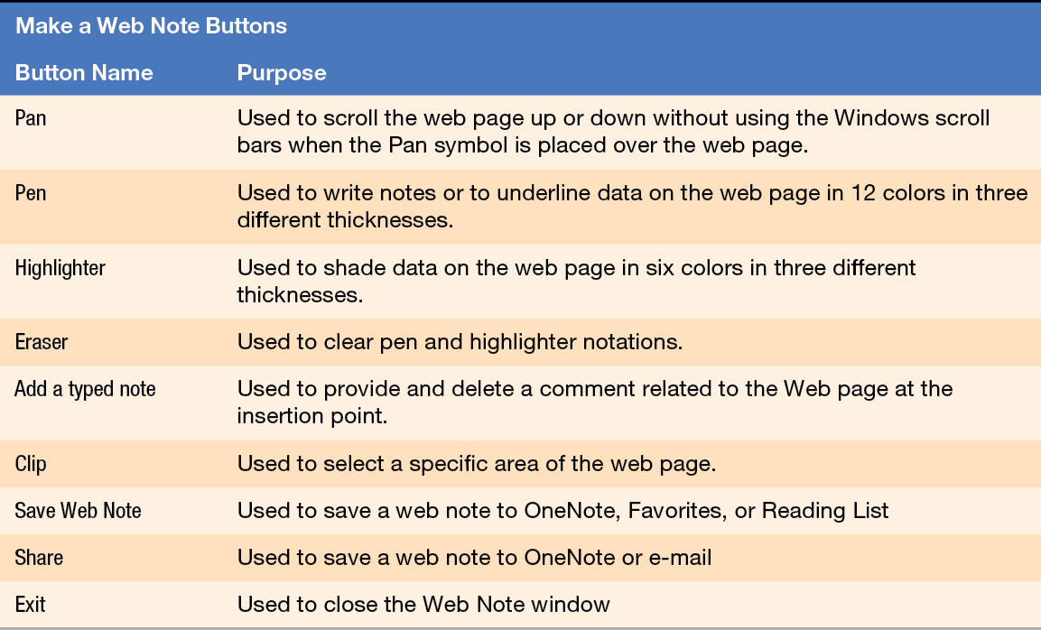
Skill 10: Create Web Notes
Notes:
In Microsoft Edge, as you search websites, you can create web notes. Web notes are items that you can highlight, clip, or annotate to read about later. They can be sent to OneNote or your Favorites or Reading list or shared through OneNote or email.

Slide 36
More Skills For Success
You will now practice the following additional skills:
Change Your Home Page
Add Navigation Tiles to the Start Menu
Use Internet Privacy Settings
Change Internet Security Settings
Notes:
You will now practice the following additional skills:
Change Your Home Page
Add Navigation Tiles to the Start Menu
Use Internet Privacy Settings
Change Internet Security Settings

Slide 37
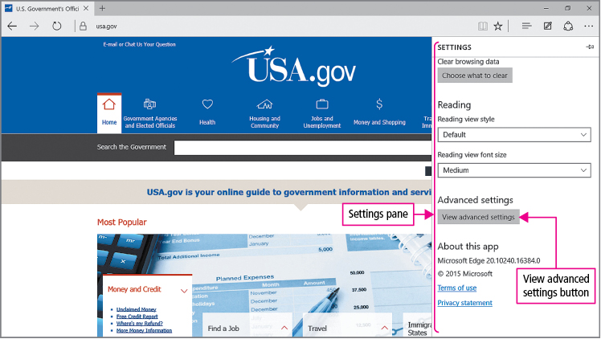
More Skills 11: Change Your Home Page
Notes:
You can set your home page to whatever website you would like, including the current page that you are on or a blank page.
The skill continues on the next slide.

Slide 38
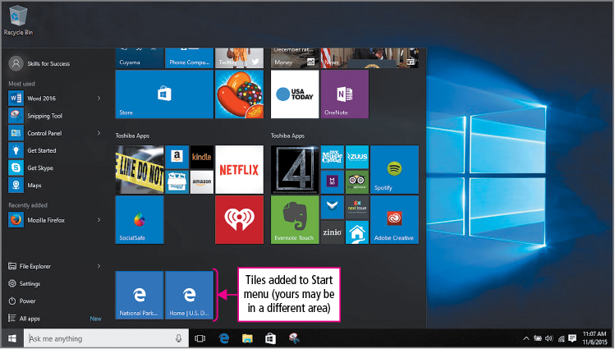
More Skills 12: Add Navigation Tiles to the Start Menu
Notes:
Web pages can be added to and opened from the Start menu.
Before the tile is created, you can change the name to whatever you would like it to be.
You can right-click a tile to unpin it from the Start menu.

Slide 39
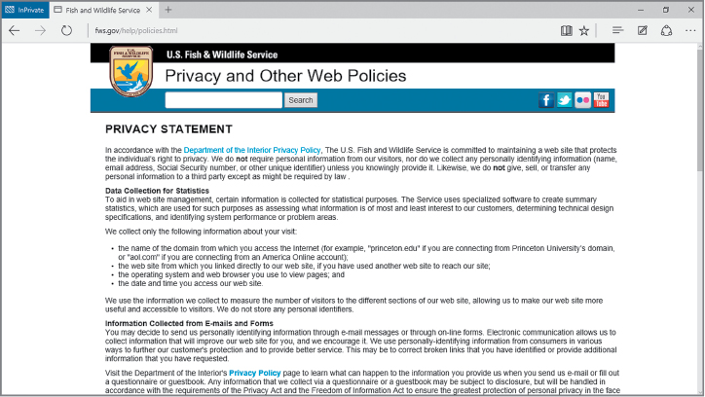
More Skills 13: Use Internet Privacy Settings
Notes:
Tracking cookies are cookies that gather information about your web browsing behaviors across multiple websites. They are used to provide ads and services based on your interests.
If you do not wish to participate in tracking services, you can turn on Tracking protection.
Pop-ups are small windows that display in addition to the web page you are viewing.
SmartScreen Filter is a feature that helps you avoid online threats.

Slide 40
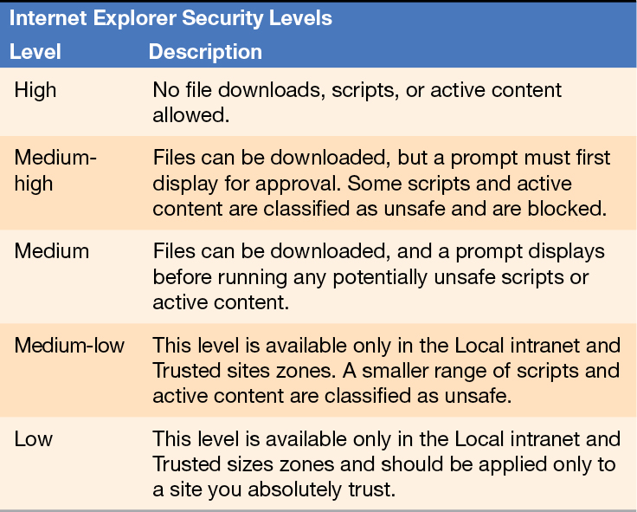
More Skills 14: Change Internet Security Settings
Notes:
Some sites use scripts and active content to download malware. Malware is a type of program that is designed to harm your computer, control your computer, or discover private information.
Scripts and active content are programs downloaded with a web page that provide additional functionality, such as dynamic content.
Websites can be assigned to the Internet zone, the Trusted sites zone, the Restricted sites zone, or the Protected Mode zone.

Slide 41
Summary
Microsoft Edge can be used to organize favorite websites
Web pages can be printed and saved
You can view and delete your browsing history
InPrivate Browsing allows you to surf the web while protecting your online privacy
Notes:
Microsoft Edge can be used to organize websites that are visited on a regular basis.
Web pages can be printed and saved.
You can view and delete your browsing history.
InPrivate Browsing helps protect your online privacy while surfing the Web.

Slide 42
Questions
Notes:
As you complete this chapter on Browsing the Internet, be sure you ask questions. You want to understand the concepts so that you can continue to build on them in future chapters.

Slide 43
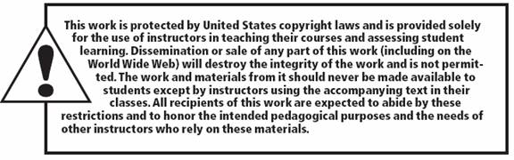
Copyright
All rights reserved. No part of this publication may be reproduced, stored in a retrieval system, or transmitted, in any form or by any means, electronic, mechanical, photocopying, recording, or otherwise, without the prior written permission of the publisher. Printed in the United States of America.

